Slide 1
SMARTCALC PRO
Multi-Functional Advanced Calculator System
Developed Using Python & Tkinter
Project By: Deepak Rajput

Slide 2
Introduction
SmartCalc Pro is an advanced desktop calculator application developed using Python and Tkinter.
Unlike traditional calculators, SmartCalc Pro combines multiple calculation systems into one unified platform.
The software provides:
Standard Calculator
Scientific Calculator
Unit Converter
Statistics Module
Programmer Calculator
Finance Calculator
Equation Solver
The project demonstrates modern GUI development, mathematical computation, and software engineering principles.

Slide 3
Problem Statement
Existing Problems
Most traditional calculators suffer from:
❌ Limited functionality
❌ No statistical operations
❌ No finance calculations
❌ No programmer support
❌ Poor user interface
❌ Multiple applications required for different calculations
Result
Users waste time switching between different software.

Slide 4
Proposed Solution
SmartCalc Pro integrates all essential calculation tools into a single platform.
Key Benefits
✅ One Software
✅ Multiple Modules
✅ Easy Navigation
✅ Modern Interface
✅ Fast Computation
✅ User Friendly Design
This reduces complexity and improves productivity.

Slide 5
Objectives
Primary Objective
Develop a professional all-in-one calculator system.
Secondary Objectives
Improve calculation efficiency
Support scientific operations
Provide financial calculations
Assist programmers
Perform statistical analysis
Solve equations quickly
Deliver modern user experience

Slide 6
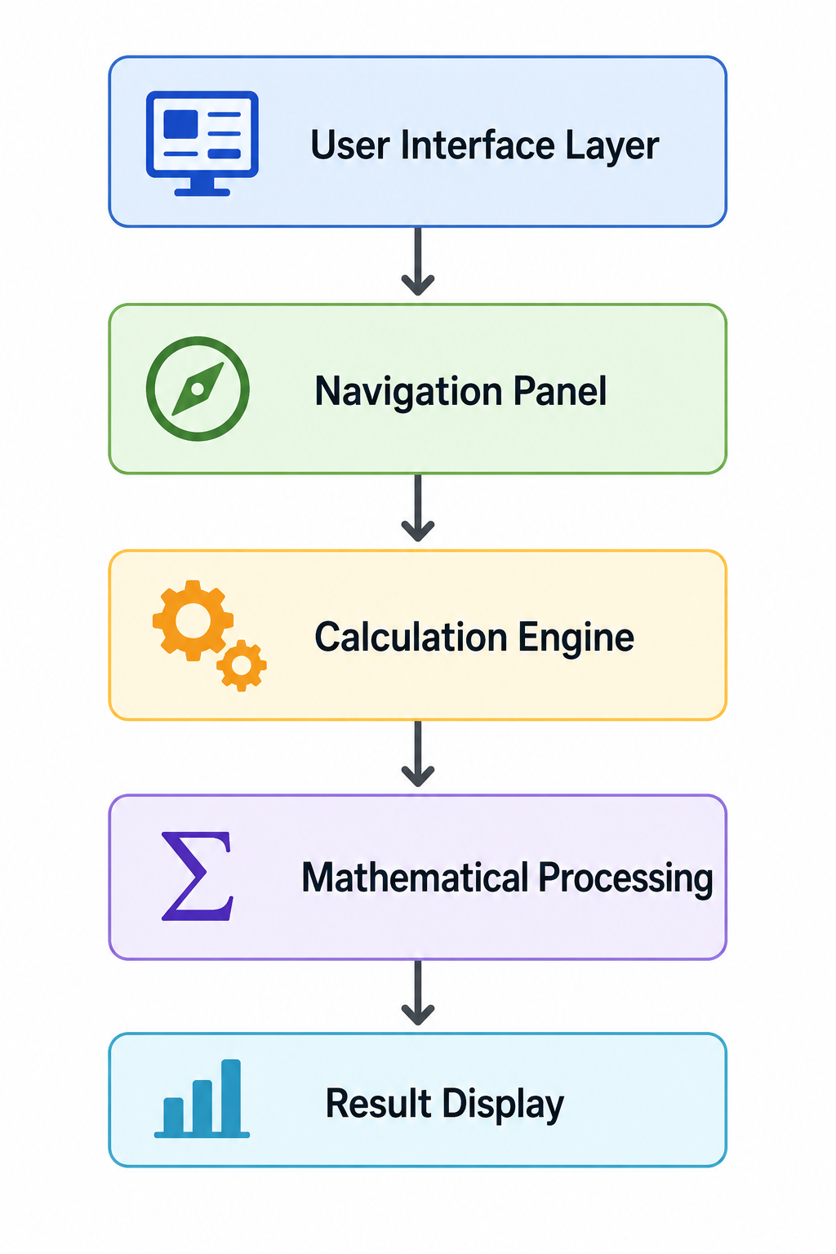

Slide 7
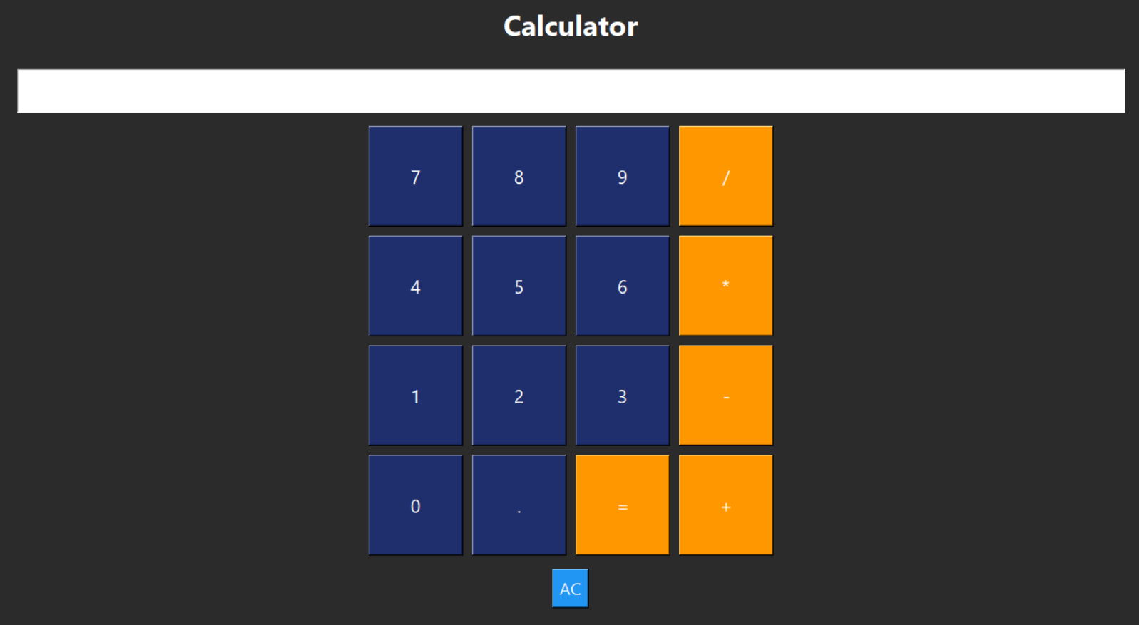
Standard Calculator Module
Features
Addition
Subtraction
Multiplication
Division
Decimal Operations
Advantages
Fast calculations
Error handling
Easy input

Slide 8
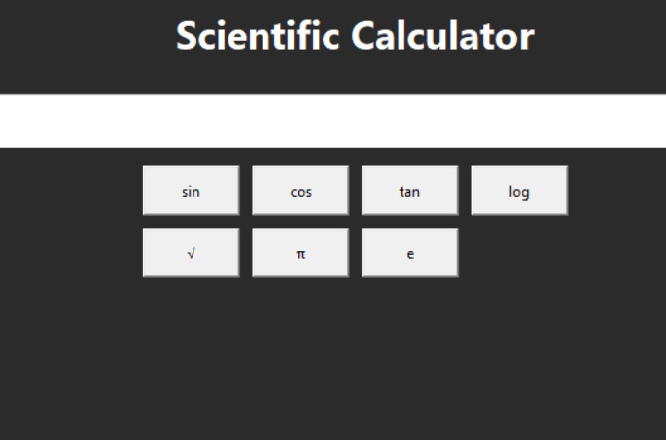
Scientific Calculator Module
Available Functions
Sin()
Cos()
Tan()
Log()
Square Root
π Constant
Euler Number (e)
Applications
Engineering
Mathematics
Physics
Education

Slide 9
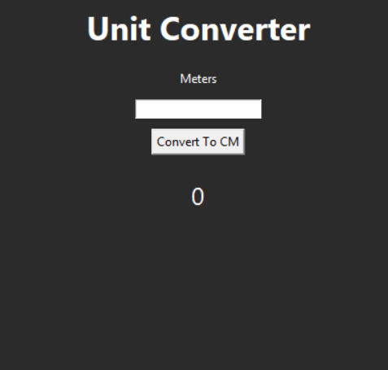
Unit Converter Module
Current Feature
Meters → Centimeters
Benefits
Quick conversion
Reduced manual errors
Educational use
Future Scope
Length
Weight
Temperature
Area
Volume

Slide 10
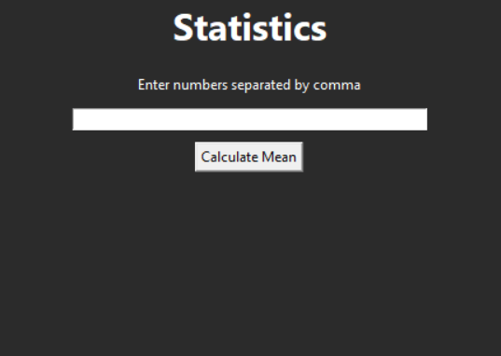
Statistics Module
Supported Operation
Mean Calculation
Process
Input Numbers
↓
Data Processing
↓
Average Calculation
↓
Result Generation
Use Cases
Data Analysis
Academic Projects
Business Reports

Slide 11
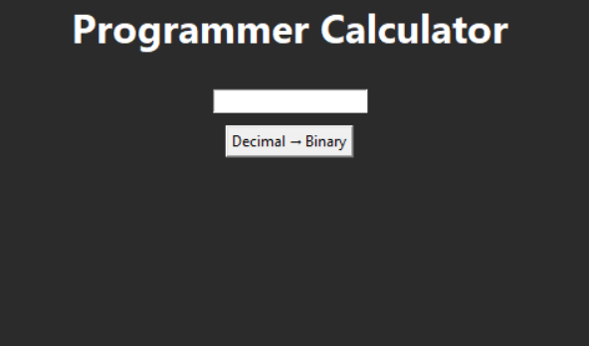
Programmer Calculator
Binary Conversion System
Functionality
Decimal → Binary Conversion
Benefits
Useful for programmers
Computer science learning
Digital electronics
Example
25 → 11001

Slide 12
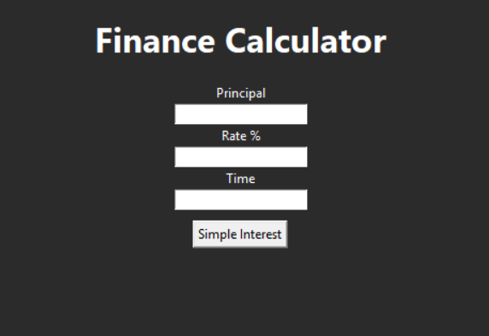
Finance Calculator
Calculates
Simple Interest
Formula
SI = (P × R × T) / 100
Where:
P = Principal
R = Rate
T = Time
Applications
Banking
Loans
Investments
Education

Slide 13
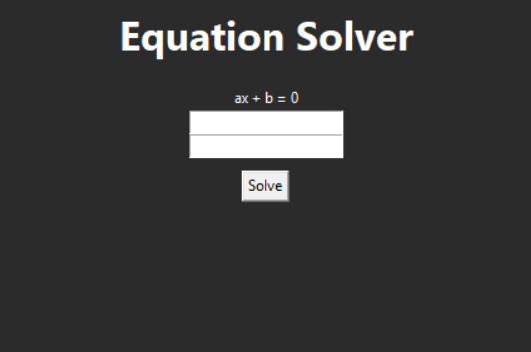
Equation Solver
Linear Equation Solver
Supported Equation
ax + b = 0
Solution Formula
x = -b/a
Advantages
Fast solution
Accurate output
Educational support

Slide 14
Why SmartCalc Pro is Better Than Other Calculators
Feature | Normal Calculator | SmartCalc Pro
Basic Operations | ✔ | ✔
Scientific Functions | ❌ | ✔
Statistics | ❌ | ✔
Finance | ❌ | ✔
Programmer Mode | ❌ | ✔
Equation Solver | ❌ | ✔
Modern GUI | ❌ | ✔
Dark Mode | ❌ | ✔

Slide 15
Unique Features
What Makes It Different?
Multi-Module Architecture
One application for multiple purposes.
Professional Dashboard
Sidebar navigation for quick access.
Dark Mode Support
Modern user experience.
Object-Oriented Design
Clean and scalable architecture.
Expandable Framework
New modules can easily be added.

Slide 16
Conclusion
SmartCalc Pro successfully demonstrates the development of a modern multi-functional calculator using Python and Tkinter.
Achievements
✔ Professional Interface
✔ Multiple Calculation Modules
✔ High Accuracy
✔ Easy Navigation
✔ Expandable Design
✔ Real-World Applications
Final Statement
"SmartCalc Pro is not just a calculator; it is a complete mathematical, financial, and analytical solution designed to improve productivity and simplify complex calculations."

Slide 17
THANK YOU
Presented By Deepak Rajput

